Slide 1
CPU scheduling algorithms
Aditya Malik and Steve Ruan

Slide 2
Project Breakdown
Testing Theoretical Data
Figuring out necessary mathematical calculations
Translating calculations into C code
Creating all test cases
Displaying and formatting results
Testing Computational Data
Understanding how Linux specifically chooses a scheduling algorithm
Writing C code that would show differences in algorithms
Running tests and recording output data
Comparing algorithm speeds and process run times

Slide 3
What Are CPU Scheduling Algorithms?
They are methods the operating system uses for selecting which process to run next whenever the CPU becomes idle; deals with the process of deciding which process in the ready queue is to be allocated to the CPU next
Few field definitions:
Turnaround time: for a process, the time interval from the submission of a process to the time of completion
Waiting time: the sum of time a process spends waiting in the ready queue
Arrival time: time from the submission of a request until the first response is produced. This is used when a process produces some output fairly early and continues computing new results while previous data is shown to the user
Burst time: amount of time the process uses the processor before it is no longer ready
Time quantum: how long a process can run before being interrupted; essentially a timer used for Round Robin

Slide 4
First Come First Serving (FCFS)
The simplest algorithm
The process that requests the CPU first is allocated to the CPU first
Easily managed by a first in first out (FIFO) queue
Downside is that average waiting time is often quite long

Slide 5
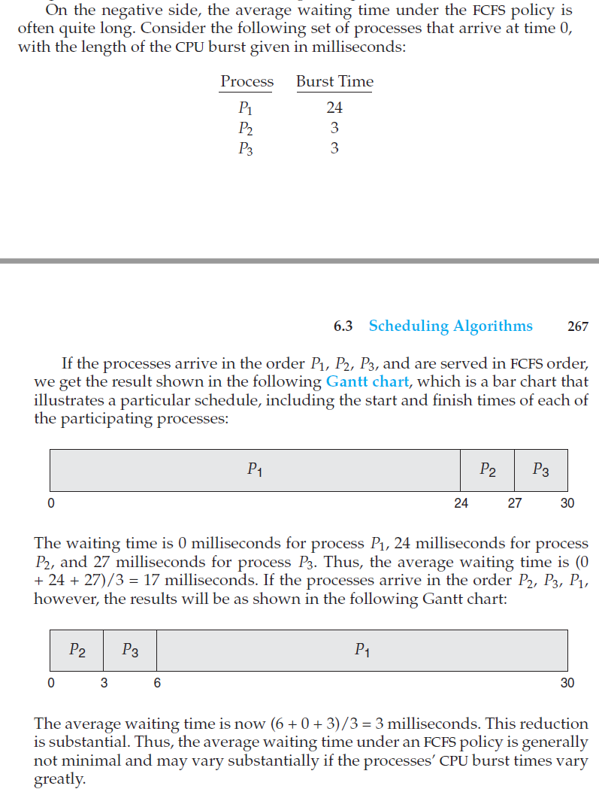
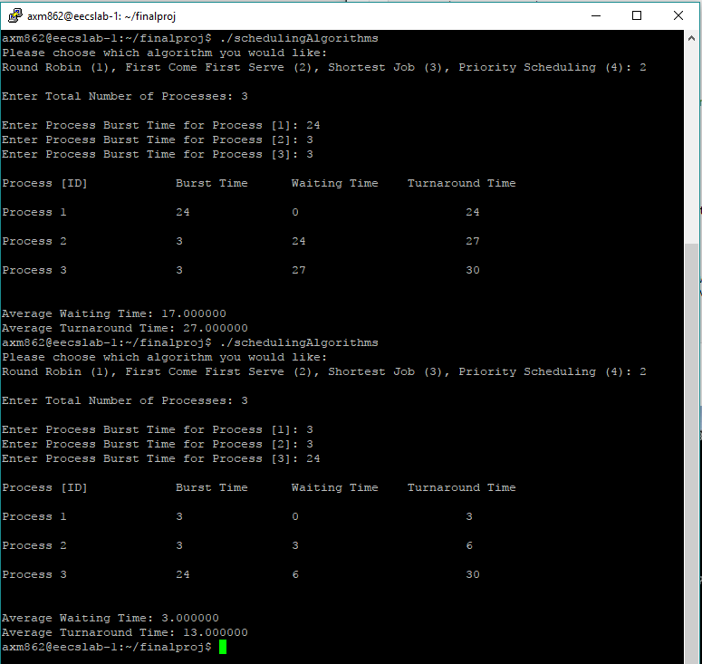
First Come First Serving (FCFS)
Burst time of process order determines waiting and turnaround times
We can reduce average times by having smaller burst time processes go first
Our data matches the book’s data

Slide 6
Shortest Job First (SJF)
When a CPU is available, it is assigned to the process that has the smallest next CPU burst
If next CPU burst of two processes are same, use FCFS scheduling
Move short processes to front to decrease average waiting time, as shown in the previous slide
This algorithm does that process automatically, but only works when you know the burst time, so not the most effective in short term scheduling where you don’t always know the length of the next CPU burst
Takes a whole lot of complicated math and time to estimate the next CPU burst

Slide 7
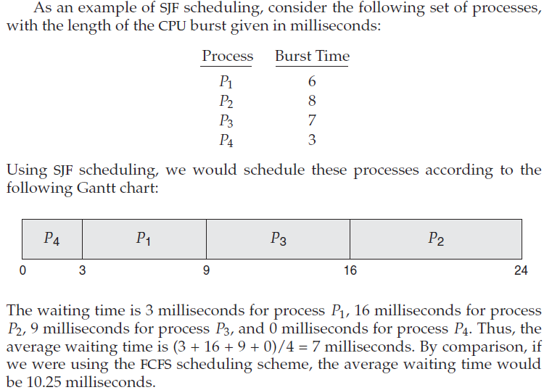
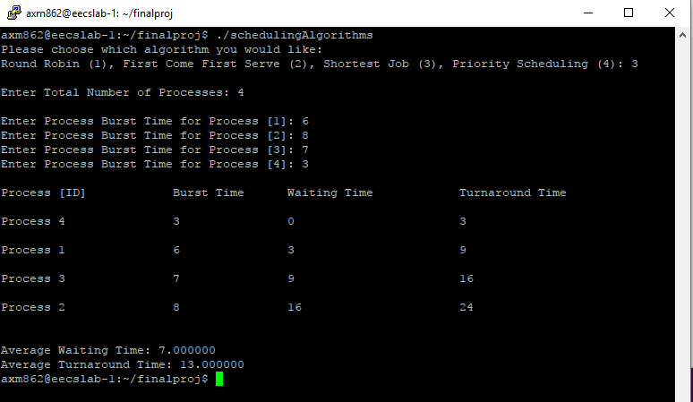
Shortest Job First (SJF)
Unlike the FCFS, the SJF algorithm figures out which process should go first based on the burst times and calculates the waiting times and turnaround times for each process

Slide 8

Priority Scheduling
A priority is associated with each process, and the CPU is allocated to the process with the highest priority
Equal priorities are scheduled using FCFS
One problem with priority scheduling is starvation, where a process is ready to run but stuck waiting for the CPU; some low priority process end up waiting indefinitely

Slide 9
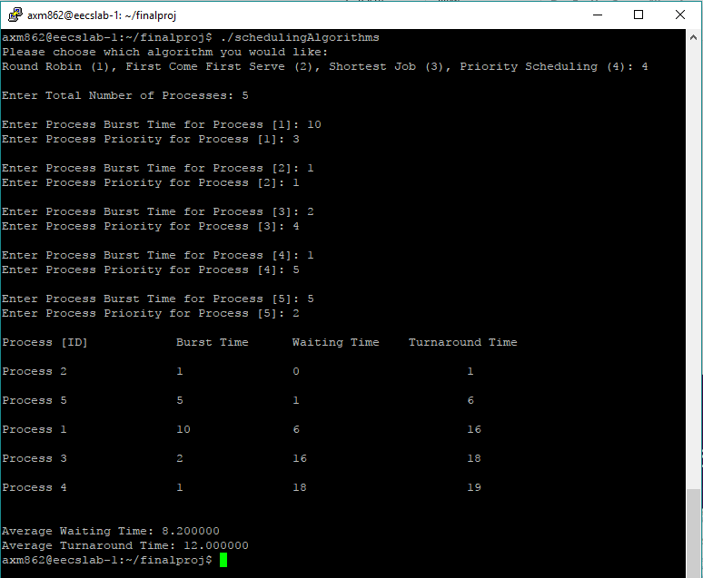
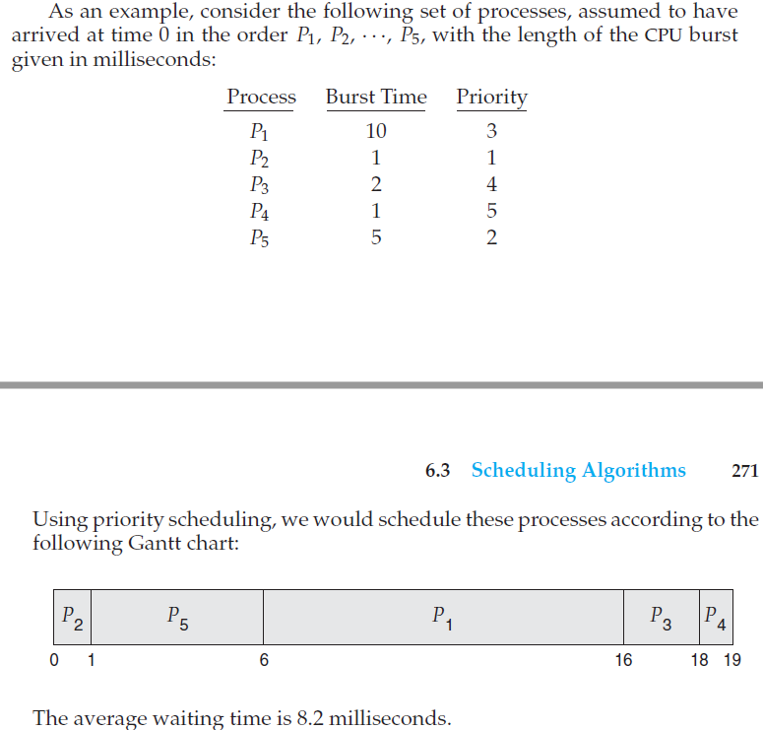
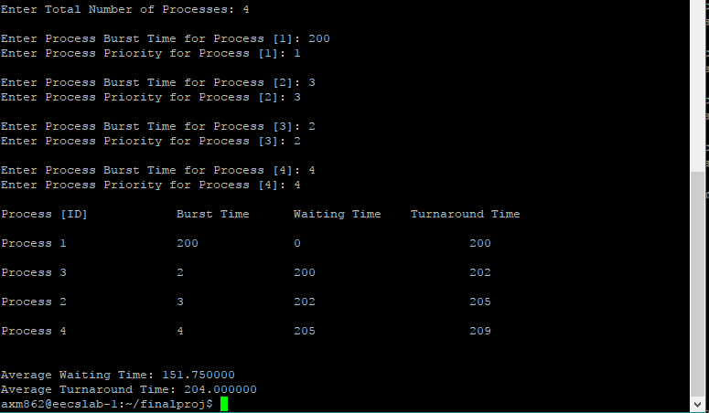
Priority Scheduling
Longer burst time on higher priority process causes extremely long wait times
Our data matches the textbook data

Slide 10
Round Robin (RR)
Designed for time-sharing systems
Average waiting time is quite long
The CPU scheduler goes to the ready queue, allocates the CPU to each process for a time up to the time quantum. The scheduler sets a timer to interrupt the process after 1 time quantum and dispatches the process. Then one of two things happen
The process may have a CPU burst of less than 1 time quantum, in which case the process releases the CPU voluntarily and the scheduler goes to the next process in the queue
If the process exceeds 1 time quantum, the timer goes off and causes an interruption. The context switch is executed, and the process is put back in the tail end of the queue, and the scheduler goes to the next process in the ready queue

Slide 11
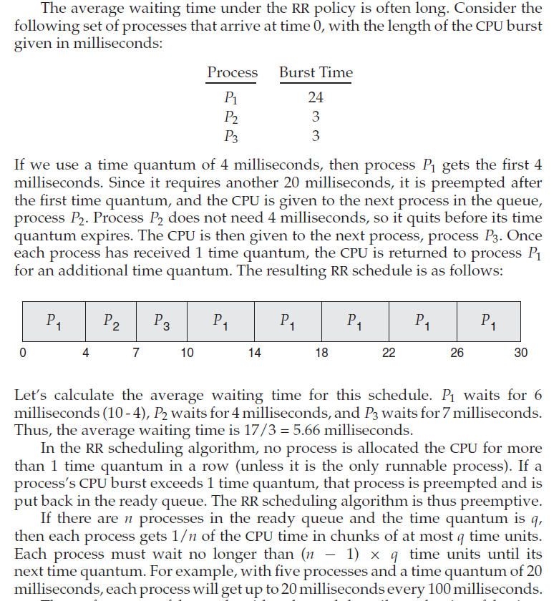
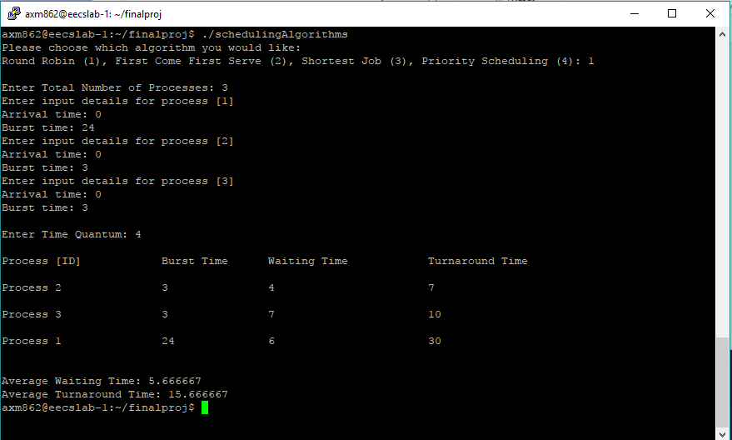
Round Robin (RR)
Process one requires more than 4 seconds (it is 24), so after 4 seconds it gets pushed back, other two run and complete (3 seconds each), then it switches back to process 1
Our data matches the data provided in the textbook for theoretical results

Slide 12
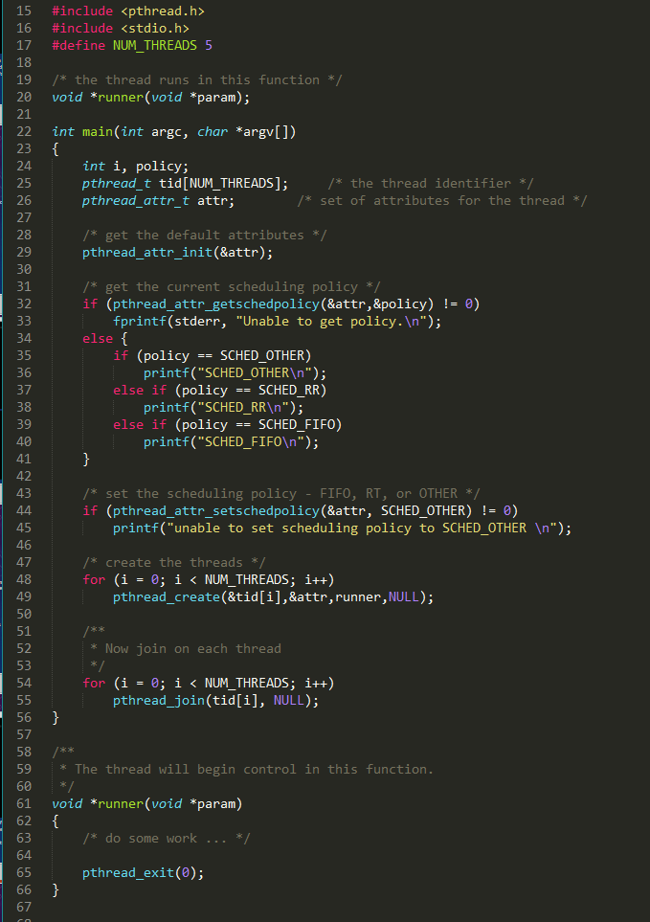
Testing the Computational Data
Use the existing posix-rt.c program provided by the professor to changed the scheduling policies (SCHED_RR or SCHED_FIFO)
Create a heavy-load thread, such as bubble sort, which takes up more computing resources
Create a few smaller-load threads, such as heap sort, which take less computing resources
Run the program using both Round Robin and FIFO methods to compare compute and run times, and if possible find the same attributes for each process as we did in the slides before
Use array to keep track of time data
We expect Round Robin to be better for jobs that aren’t the same length, and so running the identical code but simply changing the scheduling algorithm should support our expectations

Slide 13

Things Left To Do!
Currently have bubble sort algorithm working and storing into array of times
Need to implement smaller load threads correctly so they are storing time data into arrays
Compare all runtimes for both FIFO and RR to make sure our theoretical data matches expected
Display everything in organized graphs!

